Slide 1
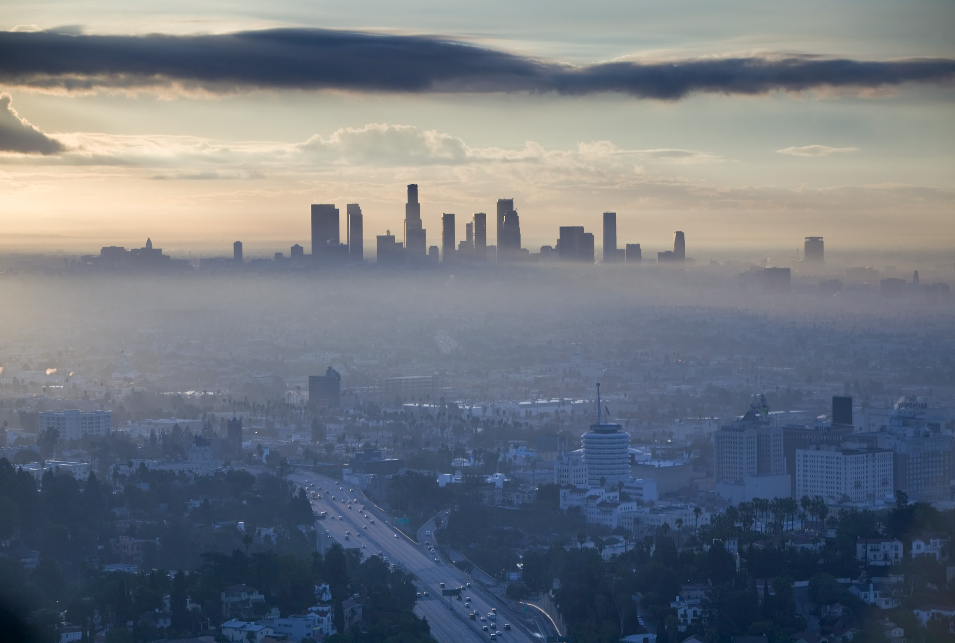
Decreasing Ozone in Los Angeles
By Deven Morris

Slide 2
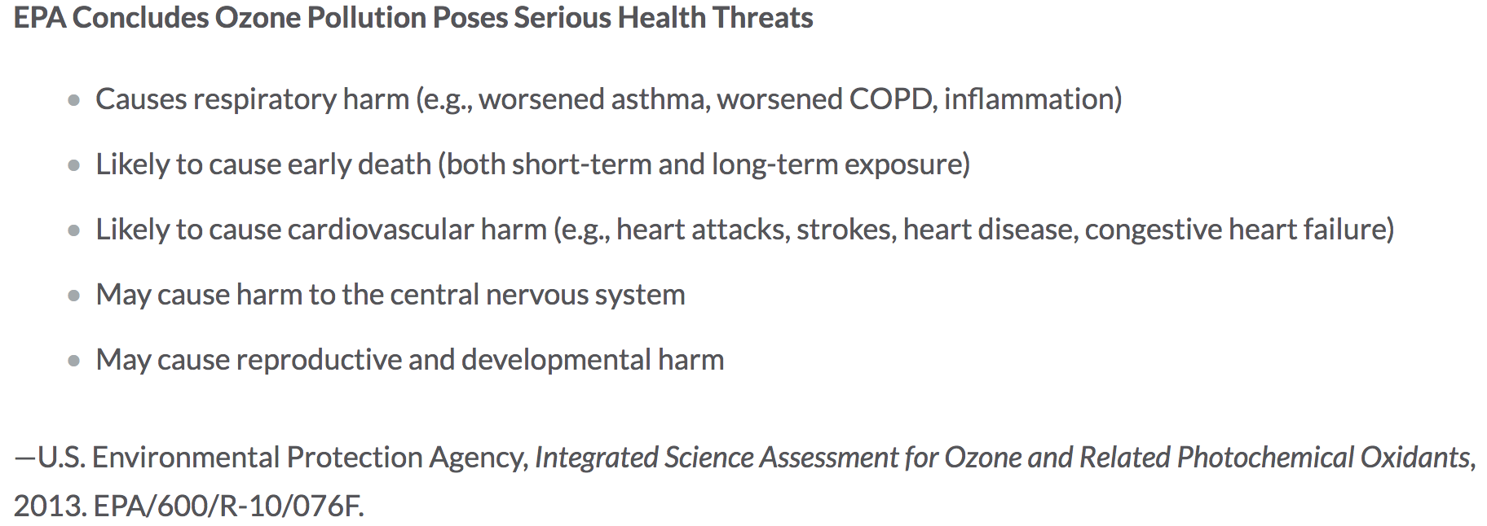
Hazards of Ozone

Slide 3
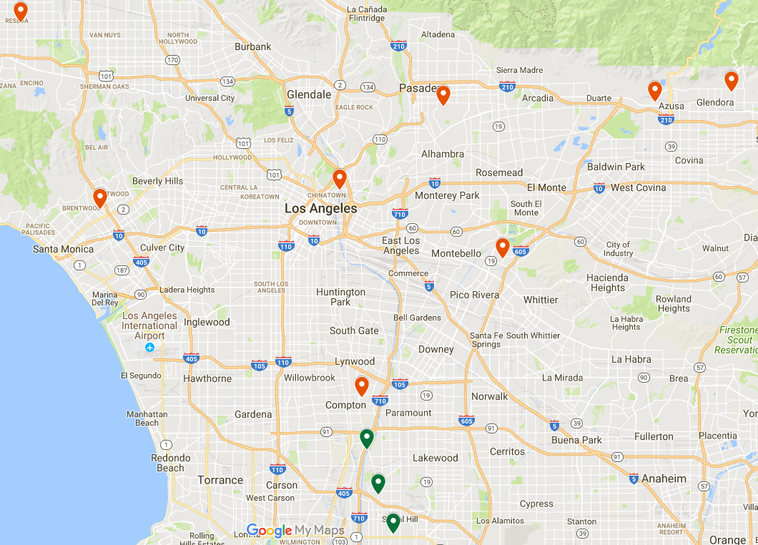


Area Concerned
Problematic
Okay

Slide 4
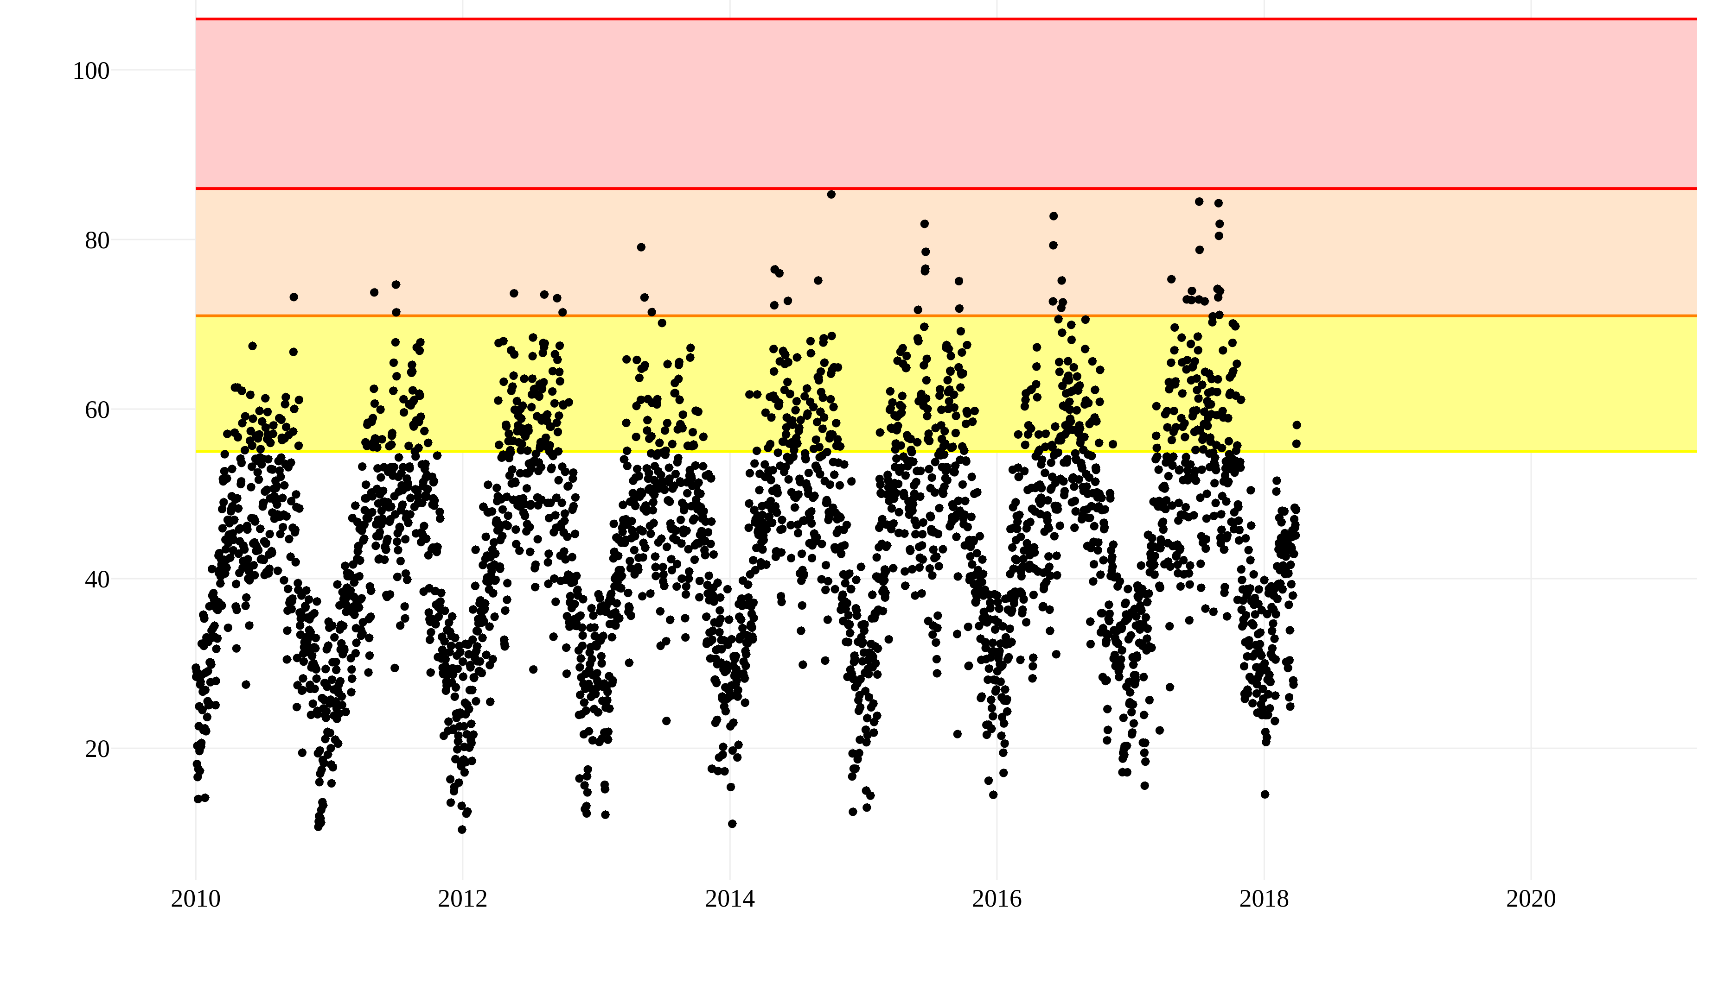
Data
Unhealthy
Sensitive Pop.
Moderate
Ozone ppb
Year

Slide 5
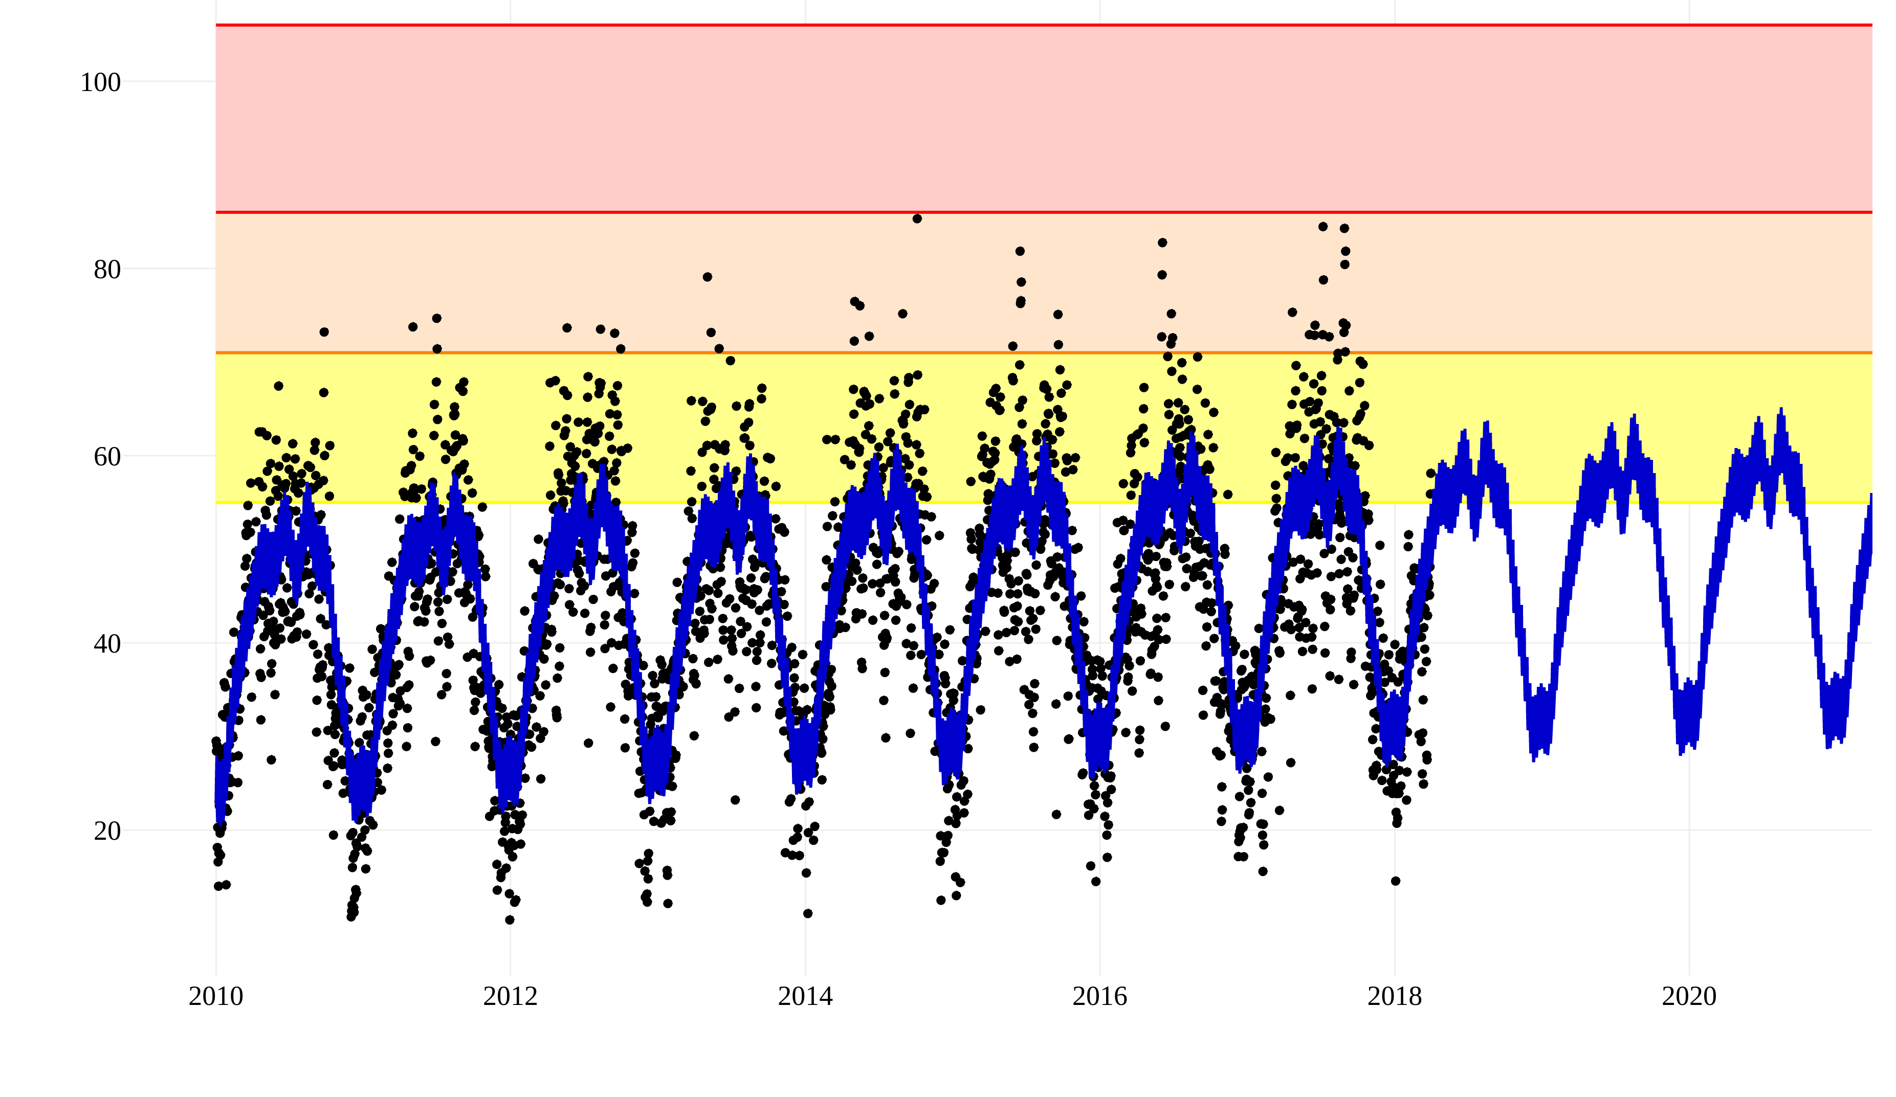
Model Fit
Unhealthy
Sensitive Pop.
Moderate
Ozone ppb
Year

Slide 6
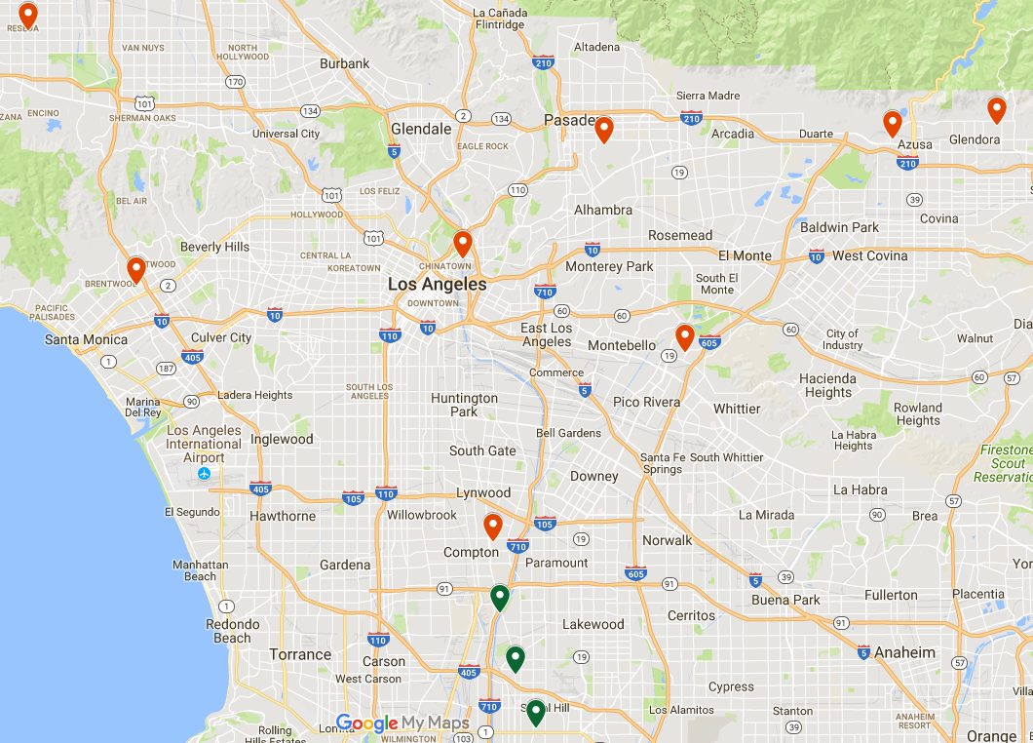
Sites of Interest
60370002
High Levels
Large Rate

Slide 7
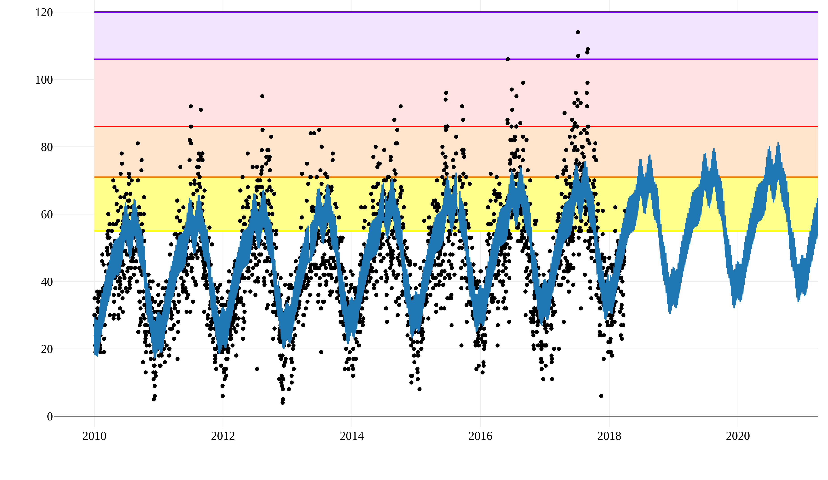
Site 60370002
Very
Unhealthy
Unhealthy
Sensitive Pop.
Ozone ppb
Moderate
Year

Slide 8

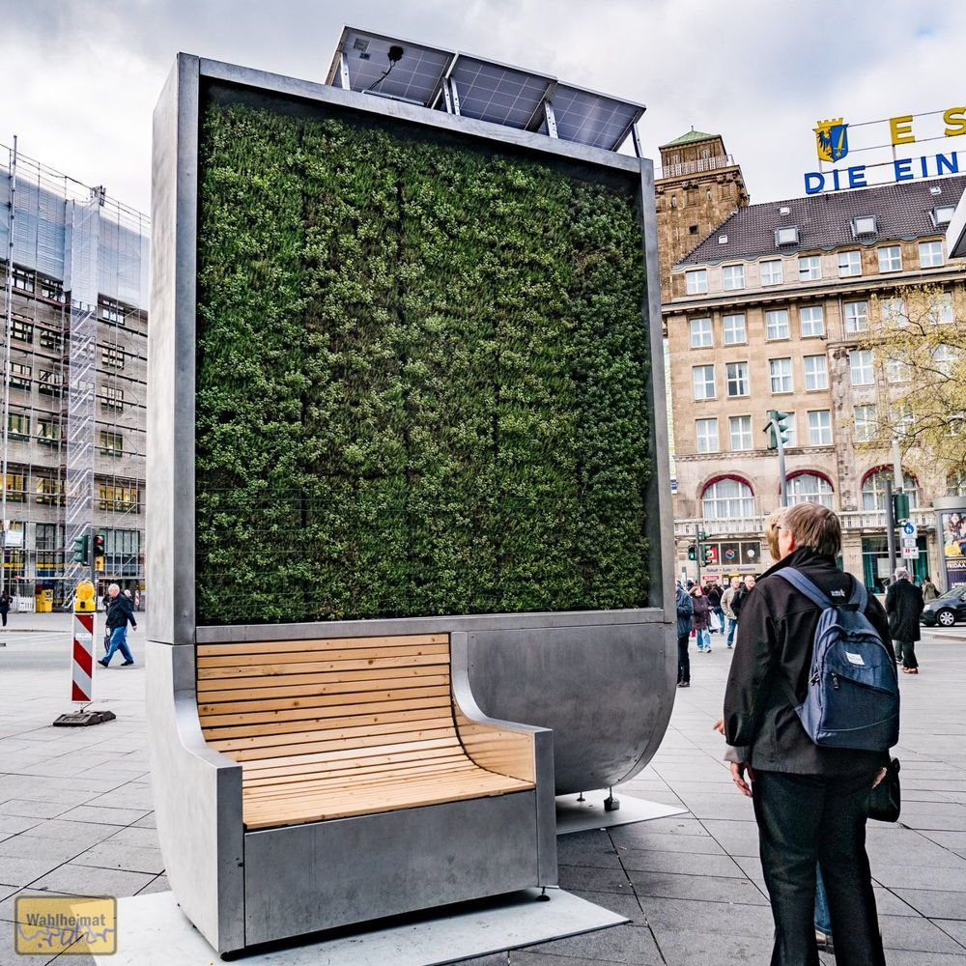
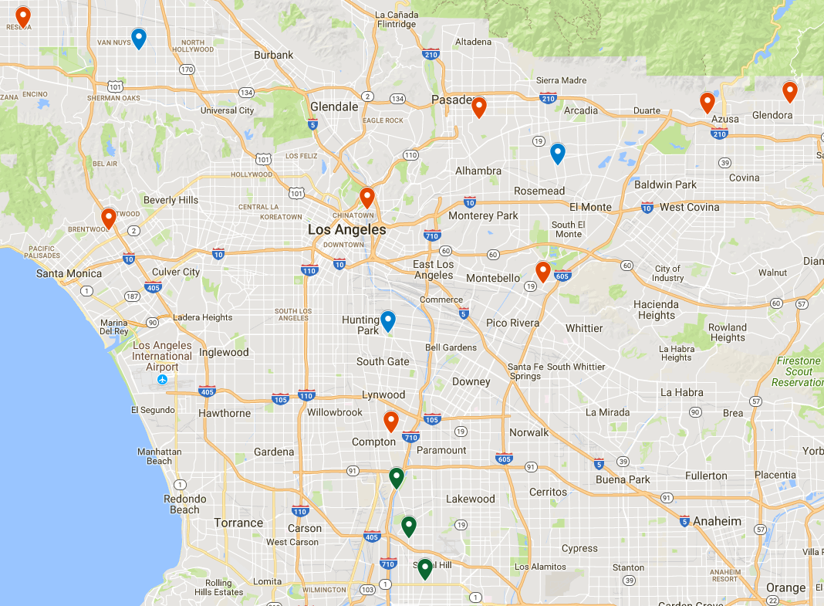
Recommendations
CityTree
CityTree Locations

Slide 9
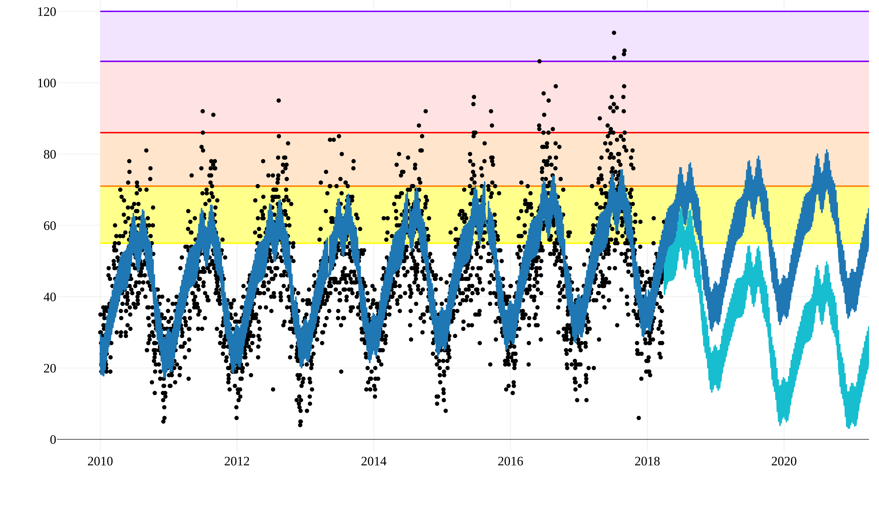
Projected Site Trend
Very
Unhealthy
Unhealthy
Sensitive Pop.
Ozone ppb
Moderate
Year

Slide 10


Next Steps
Investigate Causes
Apply to other cities

Slide 11


Thank You!
Deven Morris
djmorcode@gmail.com
913-710-7753
djmor12/
djmor/
Data: Ozone, Ozone2, News, Hazards Research: Abs. Rates, Generators, AQI
Green Tech: CityTree, Vertical Forest, General

Slide 12
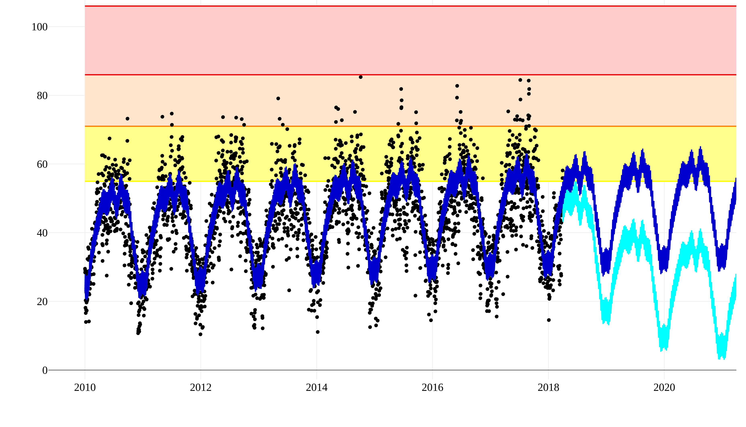
Projected L.A. Trend
Very
Unhealthy
Sensitive Pop.
Moderate
Ozone ppb
Year

Slide 13
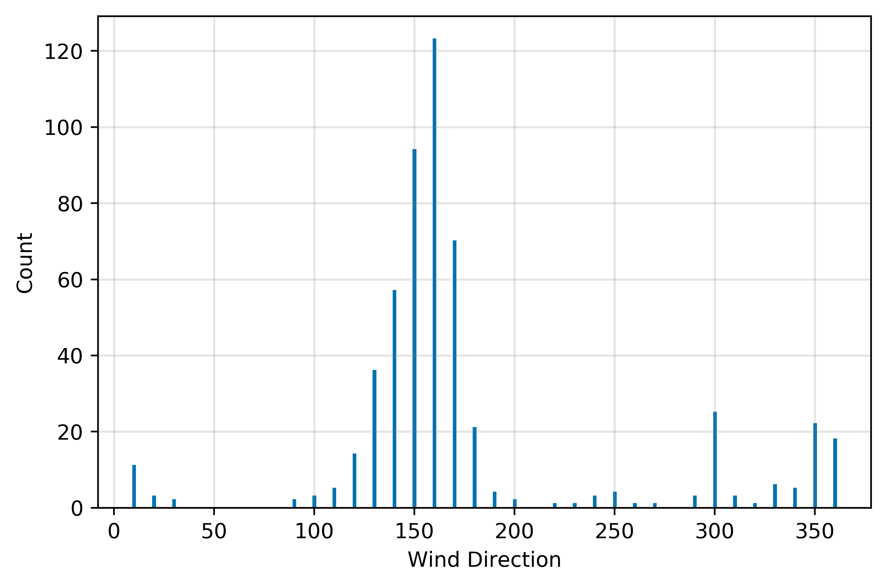
Daily Wind Direction Counts: Reseda

Slide 14
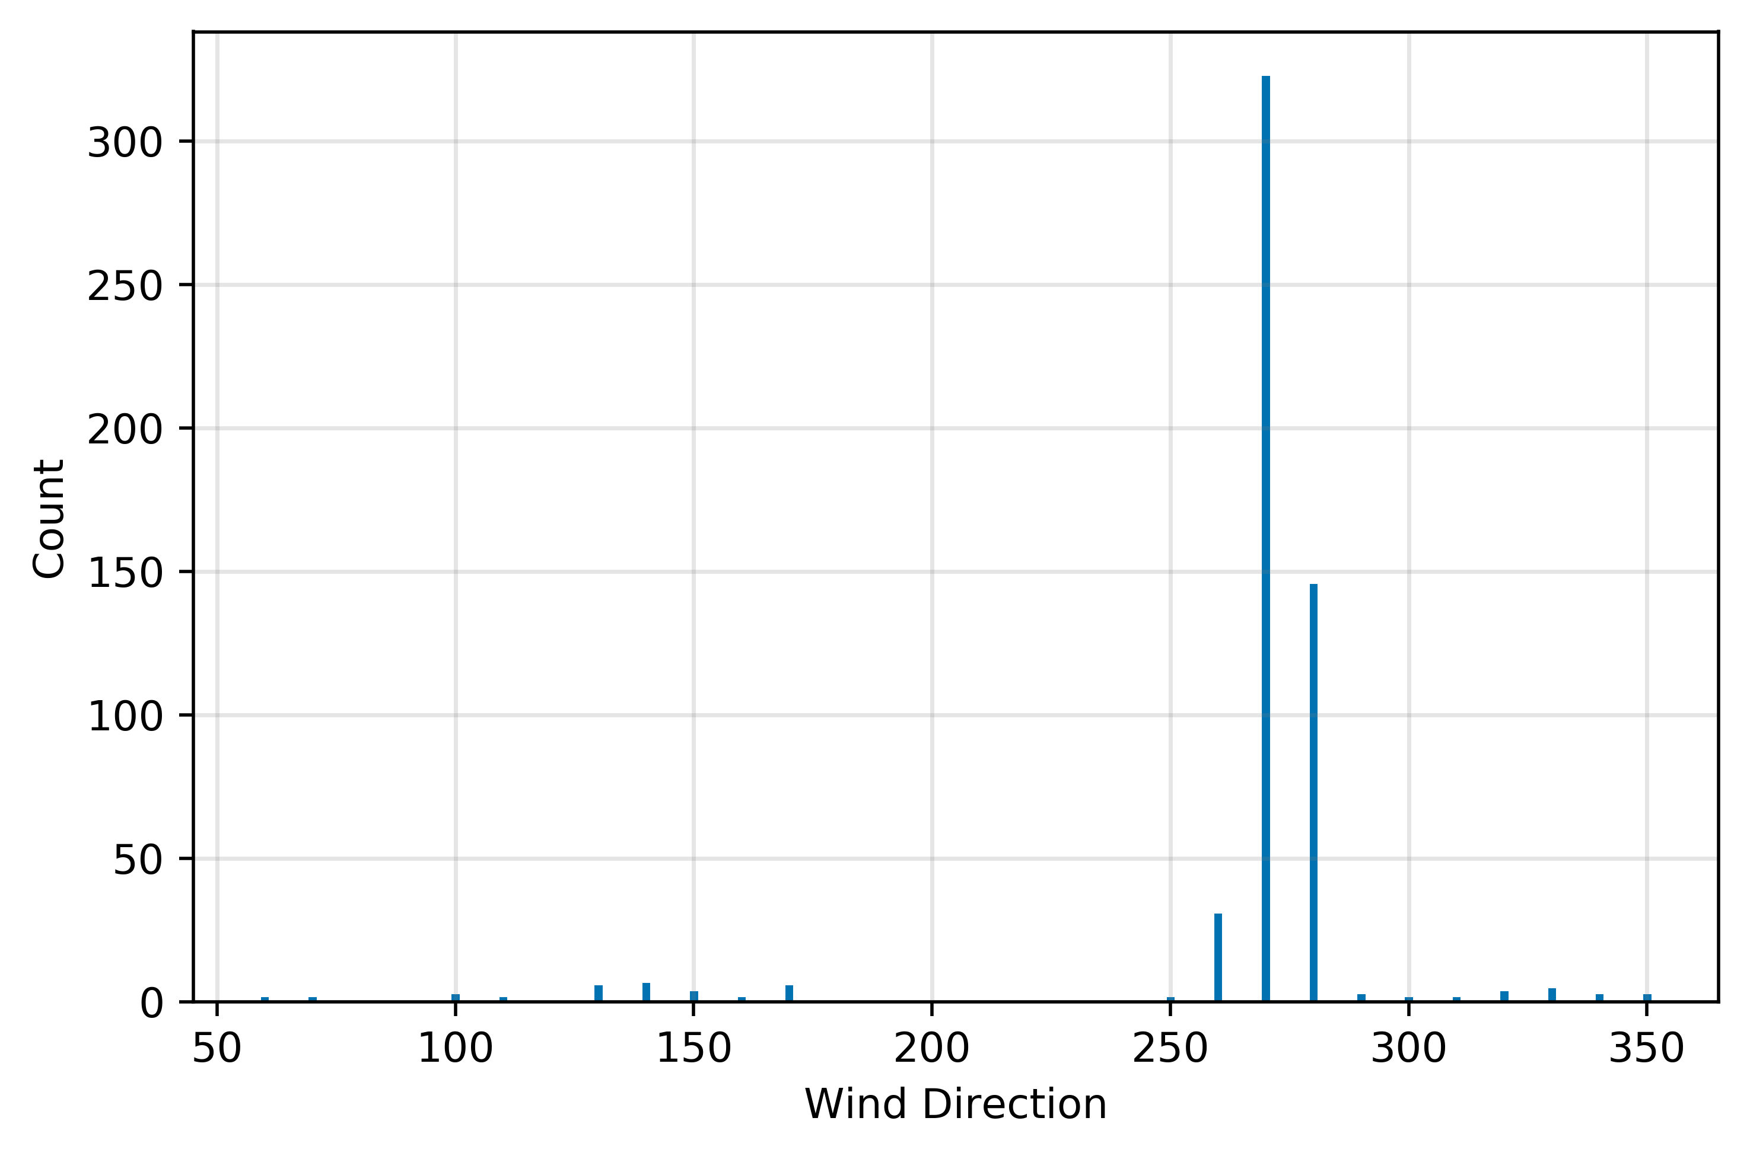
Daily Wind Direction Counts: Downtown L.A.

Slide 15
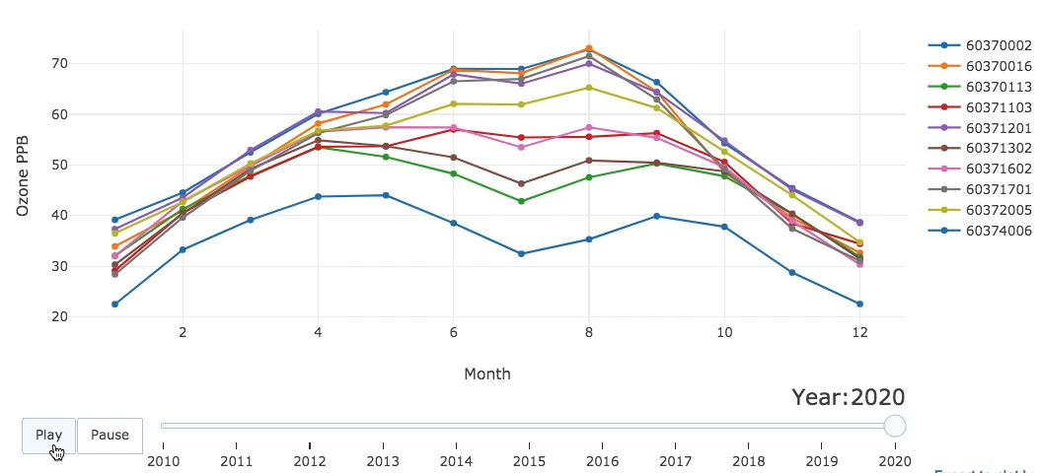
Ozone Change over Time

Slide 16
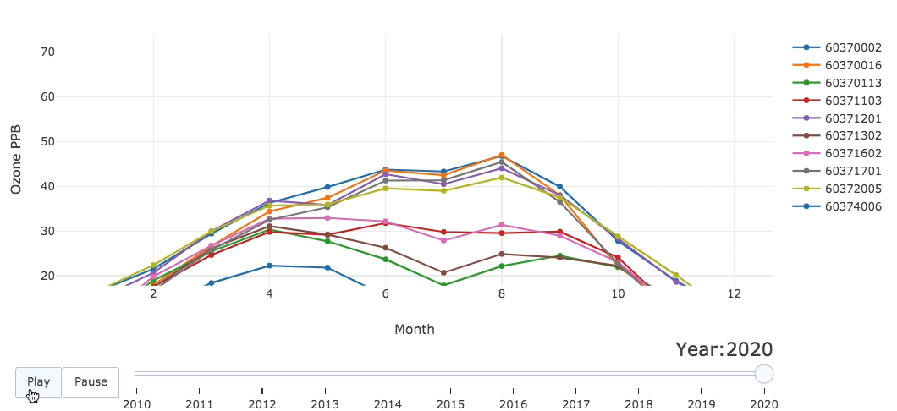
Ozone Change over Time

Slide 17
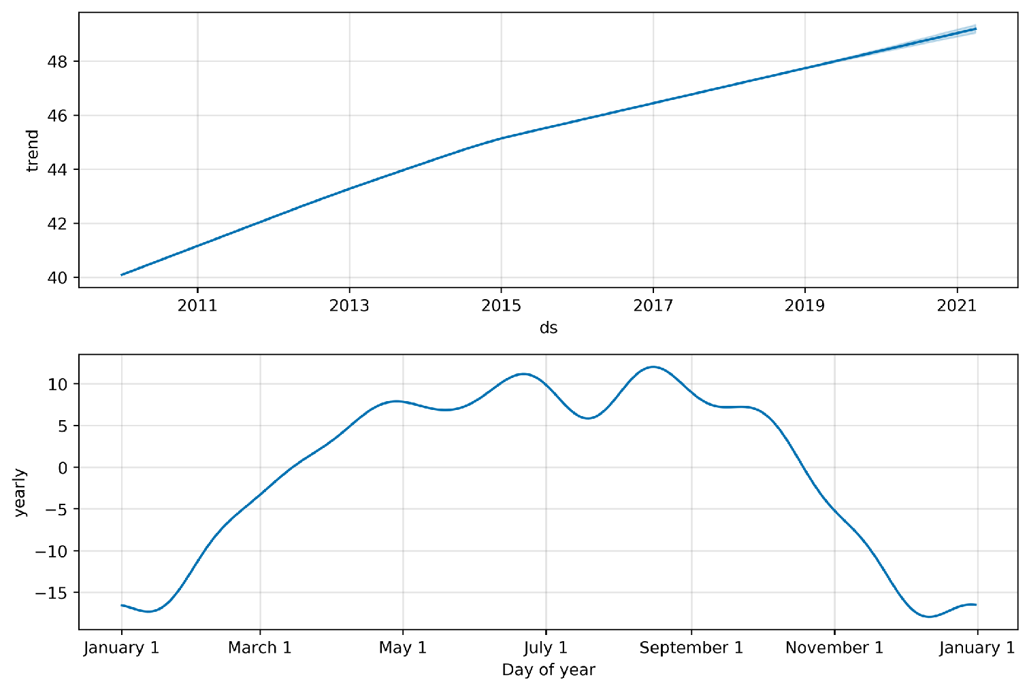
Model Fit Components

Slide 18
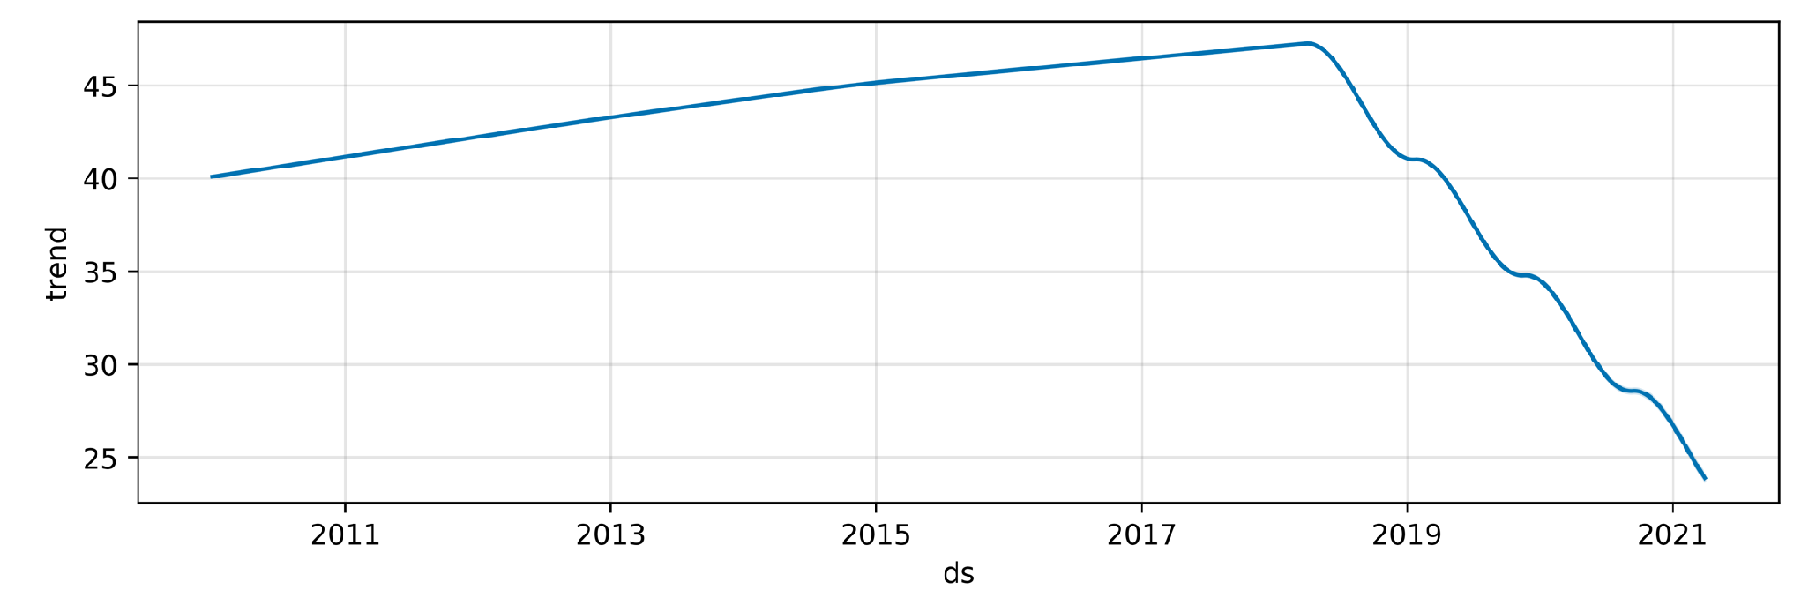
Project Trend: 3 CityTrees

Slide 19
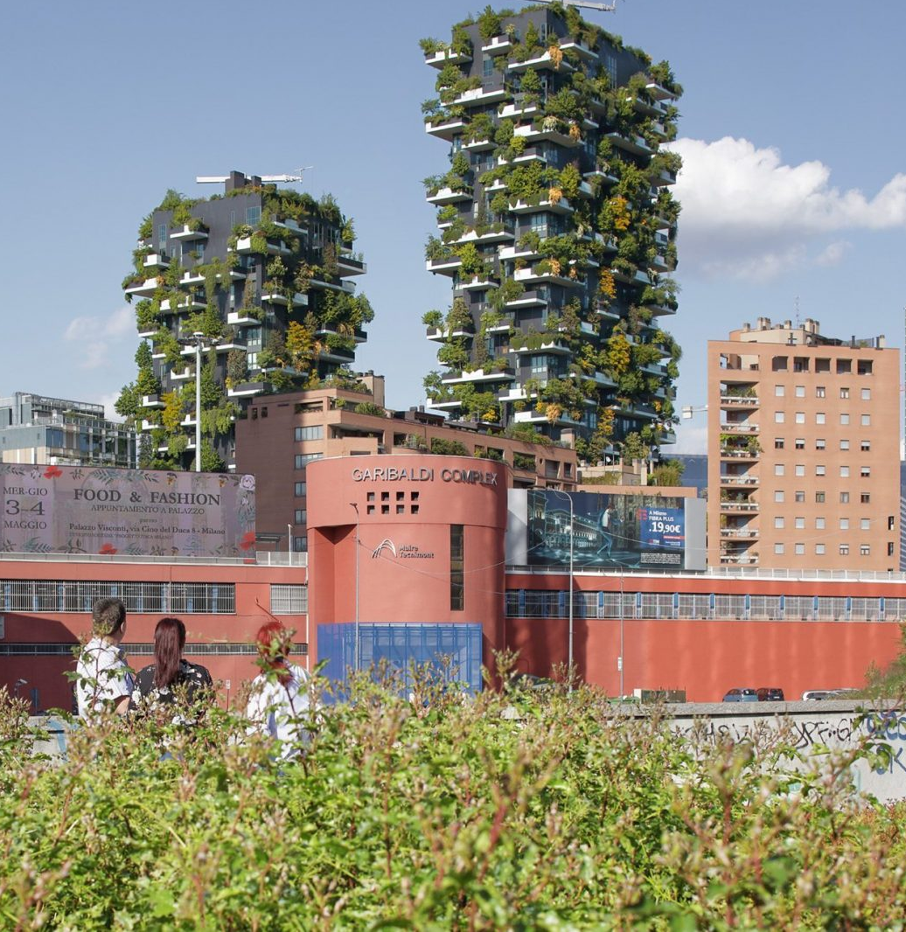
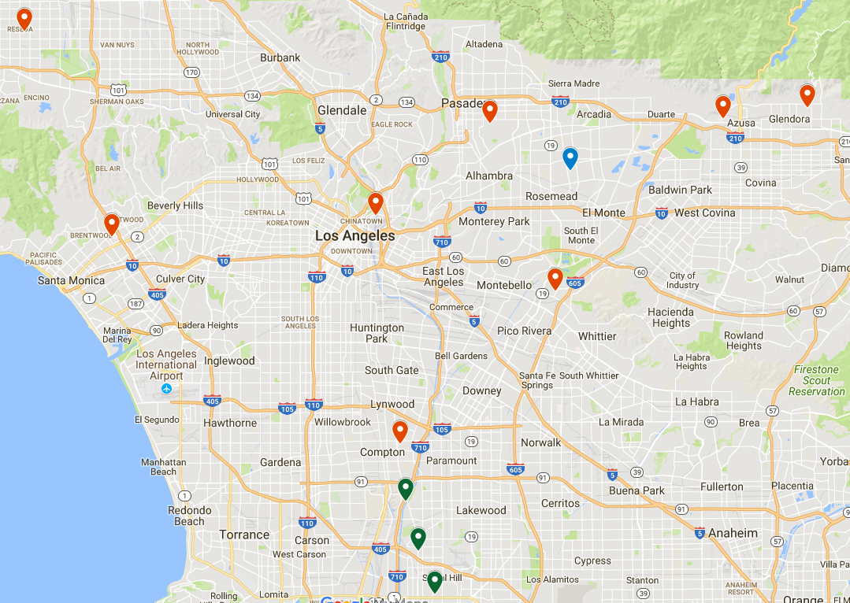
Recommendations
Vertical Forest

Slide 20
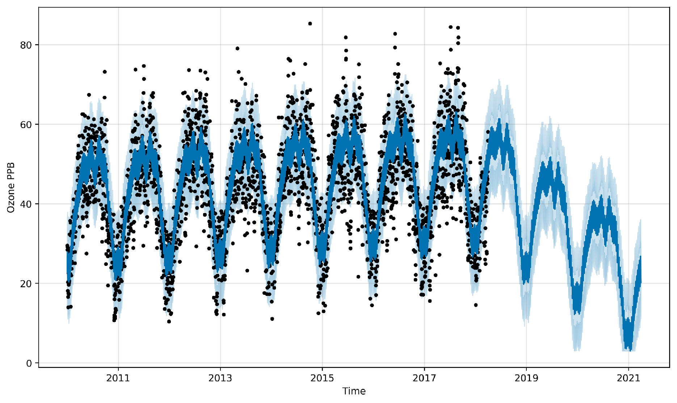
Projected Trend: Vertical Forest

Slide 21
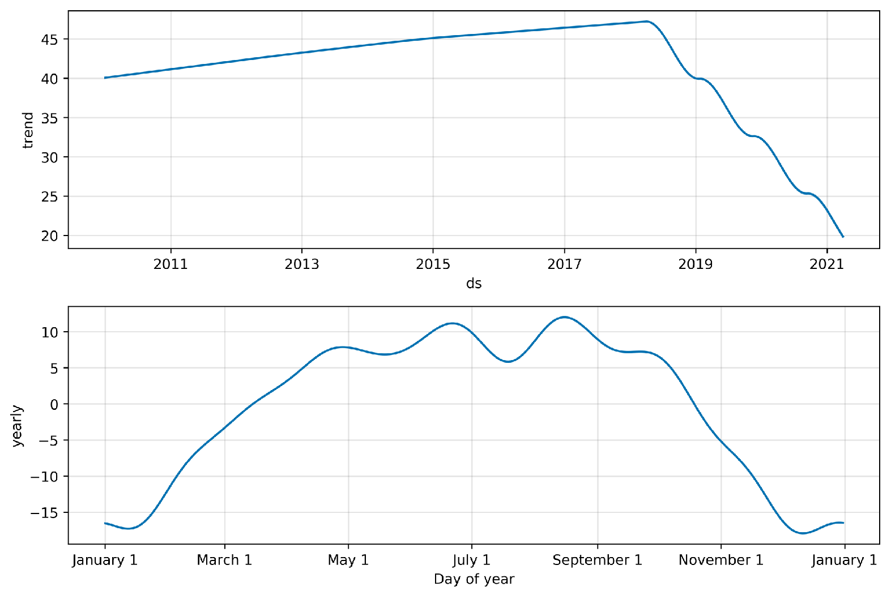
Projected Trend: Vertical Forest

